Slide 1
Reducing pain from retinopathy of prematurity eye exams: A network meta-analysis
Contact Information:
Tim.disher@dal.ca

Slide 2
RETINOPATHY OF PREMATURITY
Serious eye disease associated with preterm birth Jefferies & Canadian Paediatric Society: Fetus and Newborn Committee, 2016
Causes blindness if untreated
Related to immature vasculature of the retina
Estimated Canadian prevalence of 37/100 infants born at 32 weeks GA or less Shah, Yoon, & Chan, 2014

Slide 3
PREVENTION OF ROP
Canadian Paediatric Society guidelines recommend serial eye exams for all infants born less than 31 weeks GA as well as infants less than 1250g. Canadian Paediatric Society, 2016
Standard approach includes the use of speculum and scleral depression.

Slide 4
METHODS
BAYESIAN NETWORK META-ANALYSIS
P | Preterm infants undergoing ROP eye exam in the NICU
I | Procedure modification or Pharmacological or non-pharmacological pain relieving treatments
C | Active treatment or placebo
O | Validated pain assessment tools during (pain reactivity) and immediately after (pain recovery) eye exams, and adverse events
S | Randomized controlled trials or randomized crossover trials published in journals, as poster abstracts, or theses
Notes:
Part of Coursework

Slide 5
SEARCH STRATEGY
Databases searched
MEDLINE, Embase, Web of Science, Cochrane Central
Search strategy developed with trained systematic review librarian
Double screen for title/abstract, single data extraction
Quality appraisal
Cochrane Risk of Bias Higgins JPT et al., 2011
Notes:
Part of Coursework

Slide 6
ANALYSIS
Bayesian NMA with WinBUGS Dias, Sutton, Ades, & Welton, 2013
Corrected standard errors for cross-over trials where applicable Higgens & Green, 2013
All pain scores converted to a common scale Thorlund et al., 2011
Effects expressed as mean difference and surface under the cumulative ranking curve (SUCRA).
Consistency assessed with inconsistency model Dias et al., 2013
Notes:
Part of Coursework

Slide 8
Lumping and splitting
Issue faced by all NMAs: assess by class or each treatment individually
Advantages and drawbacks

Slide 9
PAIN REACTIVITY

Slide 10
Pain reactivity – synthesis feasibility
study | n | design | ctrl.group | trt1.group2 | trt2.group | trt3.group | method | speculum | scleral.dep | avg.pma | Containment vs Swaddle
Boyle 2006 | 40 | Parallel | drops | drops.sweet | drops.phys | drops.mult | BIO | yes | yes | 34.91 | Containment
Cogen 2011 | 39 | Parallel | plac | drops |  |  | BIO | yes | yes | 34 | Containment
Dhaliwal 2010 | 76 | Crossover | drops | WFDRI |  |  | WFDRI | yes | no | 34.1 | Containment
Dilli 2014 | 64 | Parallel | drops.phys | drops.mult |  |  | BIO | yes | unclear | 35.4 | Containment
Gal 2005 | 23 | Crossover | drops | drops.sweet |  |  | BIO | yes | yes | 33.26 | Swaddle
Grabska 2005 | 32 | Parallel | drops.phys | drops.mult |  |  | BIO | yes | yes | 35.26 | Swaddle
Kabatas 2016 | 114 | Parallel | drops | drops.paracetamol |  |  | BIO | yes | unclear | 32.4 | Containment
Kleberg 2008 | 36 | Crossover | drops | drops.mult |  |  | BIO or WFDRI | yes | yes in London | NA | Containment
Mandel 2012 | 41 | Parallel | drops.sweet | drops.sweet.NO2 |  |  | BIO | yes | yes | 35.18 | Swaddle
Marsh 2005 | 22 | Crossover | plac | drops |  |  | BIO | yes | yes | 33.01 | Containment
Mitchell 2004 | 30 | Parallel | drops.phys | drops.mult |  |  | BIO | yes | yes | 35.15 | Swaddle
Nesargi 2015 | 20 | Parallel | drops | sweet |  |  | BIO | yes | yes | 34.26 | Containment
Olsson 2011 | 30 | Parallel | drops | drops.sweet |  |  | BIO | no | unclear | NA | Containment
O'sullivan 2010 | 40 | Parallel | drops.phys | drops.mult |  |  | BIO | yes | yes | 33.1 | Swaddle
Rosali 2015 | 40 | Parallel | drops | drops.mult |  |  | BIO | yes | yes | 34.56 | Swaddle
Seifi 2013 | 120 | Parallel | drops | drops.sweet | drops.paracetamol |  | BIO | unclear | unclear | NA | Containment
Zeraati 2016 | 80 | Parallel | drops | drops.mult |  |  |  |  |  | 35.5 | Containment
ÅženerTaplak 2017 | 60 | Parallel | drops | drops | ebm.mult | sweet.mult | BIO | yes | yes | NA | Containment
Benzer 2015 | 64 | Parallel | plac | sweet.rep | sweet.single |  |  |  |  | NA
Ilarslan 2012 | 40 | Parallel | drops.phys | drops.mult |  |  |  | yes |  | NA
Ucar 2014 | 84 | Parallel | drops.phys | drops.sweet | drops.mult |  |  |  |  | 34.2
Xin 0016 | 95 | Parallel | drops | drops.sweet |  |  |  |  |  | NA

Slide 11
PIPP Reactivity Drops Response Rate
15
10
PIPP (mean or median)
5
0
Boyle 2006
Gal 2005
Marsh 2005
Seifi 2013
Xin 0016
Cogen 2011
Rosali 2015
Zeraati 2016
Olsson 2011
Kleberg 2008
Nesargi 2015
Dhaliwal 2010
Kabatas 2016
Study ID

Slide 12
PIPP Reactivity Drops Response Rate Colours = Actual Timepoints
15
Actual Timepoint
10
start of exam
PIPP (mean or median)
DIO+dep
60
seconds
during
speculum insertion
999
first 45 seconds
5
during procedure
0
Boyle 2006
Gal 2005
Marsh 2005
Seifi 2013
Xin 0016
Cogen 2011
Rosali 2015
Zeraati 2016
Olsson 2011
Kleberg 2008
Nesargi 2015
Dhaliwal 2010
Kabatas 2016
Study ID

Slide 13
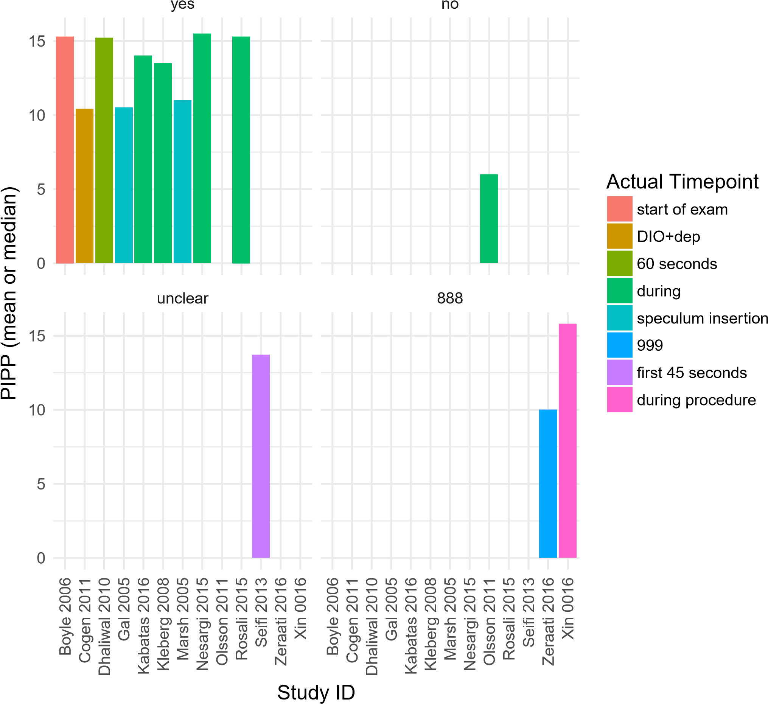
PIPP Reactivity Drops Response Rate Faceted by speculum

Slide 14
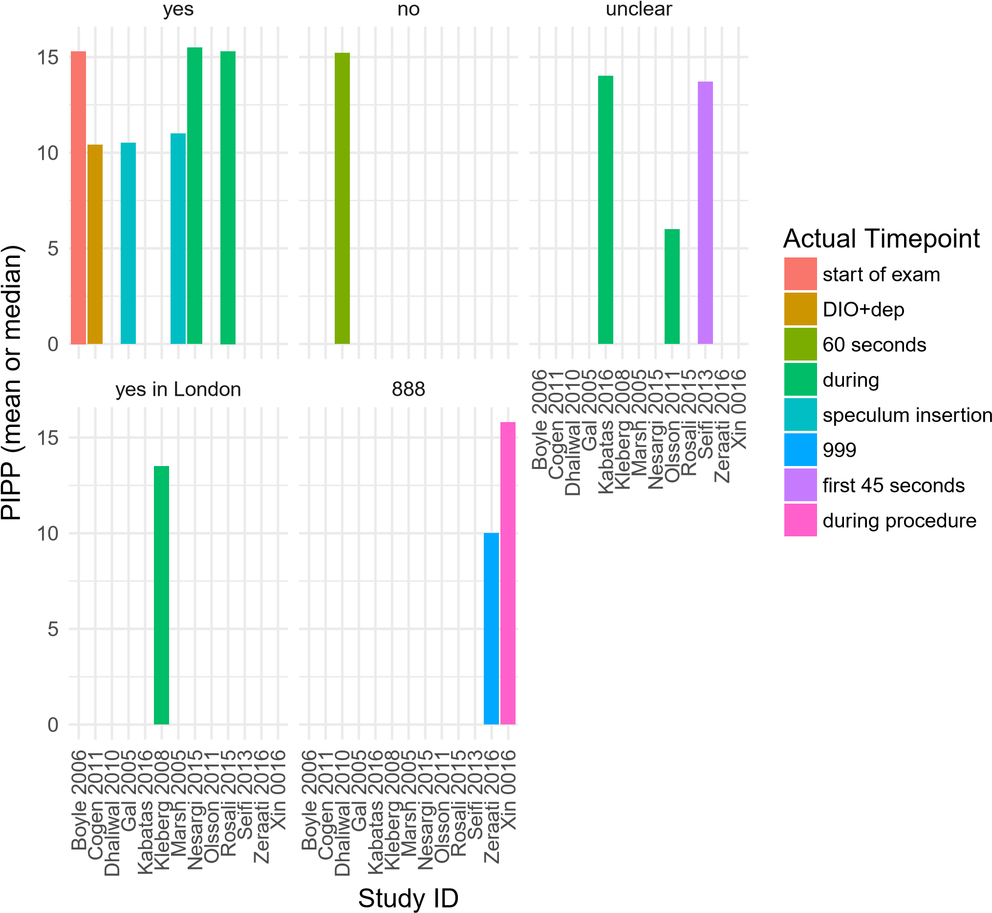
PIPP Reactivity Drops Response Rate Faceted by scleral depresion

Slide 15
PIPP Reactivity Drops Response Rate Faceted by Containment vs Swaddle
Containment
Swaddle
15
10
5
Actual Timepoint
start of exam
PIPP (mean or median)
DIO+dep
0
60
seconds
888
Gal 2005
Xin 0016
during
Boyle 2006
Marsh 2005
Seifi 2013
Cogen 2011
Rosali 2015
Zeraati 2016
Olsson 2011
Nesargi 2015
Kleberg 2008
Kabatas 2016
Dhaliwal 2010
speculum insertion
15
999
first 45 seconds
10
during procedure
5
0
Gal 2005
Xin 0016
Boyle 2006
Marsh 2005
Seifi 2013
Cogen 2011
Rosali 2015
Zeraati 2016
Olsson 2011
Nesargi 2015
Kleberg 2008
Kabatas 2016
Dhaliwal 2010
Study ID

Slide 16
PIPP Reactivity Drops Response Rate Scatter
16
●
Xin 0016
Nesargi
Boyle 2006
Boyle 2006
●
●
2
●
●
Dhaliwal 2010
studlab
●
Kabatas 2016
a
14
●
Seifi 2013
●
Seifi 2013
●
●
Kleberg 2008
a
●
a
●
a
●
a
12
●
a
PIPP (mean or median)
●
a
●
a
●
Gal 2005
●
a
10
●
Zeraati 2016
●
a
●
n1
●
20
a
8
●
a
40
●
a
60
6
●
Olsson 2011
drops.sweet
drops.mult
drops.wfdri
drops.tyl
sweet

Slide 18
PAIN RECOVERY

Slide 19
Pain recovery – synthesis feasibility
study | n | design | ctrl.group | trt1.group2 | trt2.group | trt3.group | method | speculum | scleral.dep | avg.pma | Containment vs Swaddle
ÅženerTaplak 2017 | 60 | Parallel | drops | drops | ebm.mult | sweet.mult | BIO | yes | yes | NA | Containment
Gal 2005 | 23 | Crossover | drops | drops.sweet |  |  | BIO | yes | yes | 35.19 | Swaddle
Grabska 2005 | 32 | Parallel | drops.phys | drops.mult |  |  | BIO | yes | yes | 35.45 | Swaddle
Manjunatha 2009 | 18 | Parallel | drops | drops.morphine | drops.paracetamol |  | BIO | yes | yes | NA | Containment
Marsh 2005 | 22 | Crossover | plac | drops |  |  | BIO | yes | yes | NA | Containment
Mehta 2010 | 40 | Crossover | phys | drops.phys |  |  | BIO | yes | yes | NA | Swaddle
Mitchell 2004 | 30 | Parallel | drops.phys | drops.mult |  |  | BIO | yes | yes | NA | Swaddle
Nesargi 2015 | 20 | Parallel | drops | sweet |  |  | BIO | yes | yes | 35.18 | Containment
Rosali 2015 | 40 | Parallel | drops | drops.mult |  |  | BIO | yes | yes | NA | Swaddle
Seifi 2013 | 120 | Parallel | drops | drops.sweet | drops.paracetamol |  | BIO | unclear | unclear | NA | Containment
Zeraati 2016 | 80 | Parallel | drops | drops.mult |  |  |  |  |  | NA | Containment

Slide 20
PIPP Recovery Drops Response Rate
12
8
PIPP (mean or median)
4
0
Gal 2005
Marsh 2005
Nesargi 2015
Rosali 2015
Seifi 2013
Zeraati 2016
Manjunatha 2009
Study ID

Slide 21
PIPP Recovery Drops Response Rate Colours = Actual Timepoints
12
8
Actual Timepoint
PIPP (mean or median)
5
min post
1
min post−exam
post−exam
999
last 45 seconds
4
0
Gal 2005
Marsh 2005
Nesargi 2015
Rosali 2015
Seifi 2013
Zeraati 2016
Manjunatha 2009
Study ID

Slide 22
PIPP Recovery Drops Response Rate Faceted by speculum
yes
unclear
12
8
4
Actual Timepoint
PIPP (mean or median)
5
min post
0
1
min post−exam
888
Gal 2005
Marsh 2005
Seifi 2013
post−exam
Rosali 2015
Zeraati 2016
Nesargi 2015
12
Manjunatha 2009
999
last 45 seconds
8
4
0
Gal 2005
Seifi 2013
Marsh 2005
Rosali 2015
Zeraati 2016
Nesargi 2015
Manjunatha 2009
Study ID

Slide 23
PIPP Recovery Drops Response Rate Faceted by scleral depresion
yes
unclear
12
8
4
Actual Timepoint
PIPP (mean or median)
5
min post
0
1
min post−exam
888
Gal 2005
Marsh 2005
Seifi 2013
post−exam
Rosali 2015
Zeraati 2016
Nesargi 2015
12
Manjunatha 2009
999
last 45 seconds
8
4
0
Gal 2005
Seifi 2013
Marsh 2005
Rosali 2015
Zeraati 2016
Nesargi 2015
Manjunatha 2009
Study ID

Slide 24
PIPP Recovery Drops Response Rate Faceted by Containment vs Swaddle
Containment
12
8
4
Actual Timepoint
PIPP (mean or median)
5
min post
0
1
min post−exam
Swaddle
post−exam
12
999
last 45 seconds
8
4
0
Gal 2005
Marsh 2005
Nesargi 2015
Rosali 2015
Seifi 2013
Zeraati 2016
Manjunatha 2009
Study ID

Slide 25
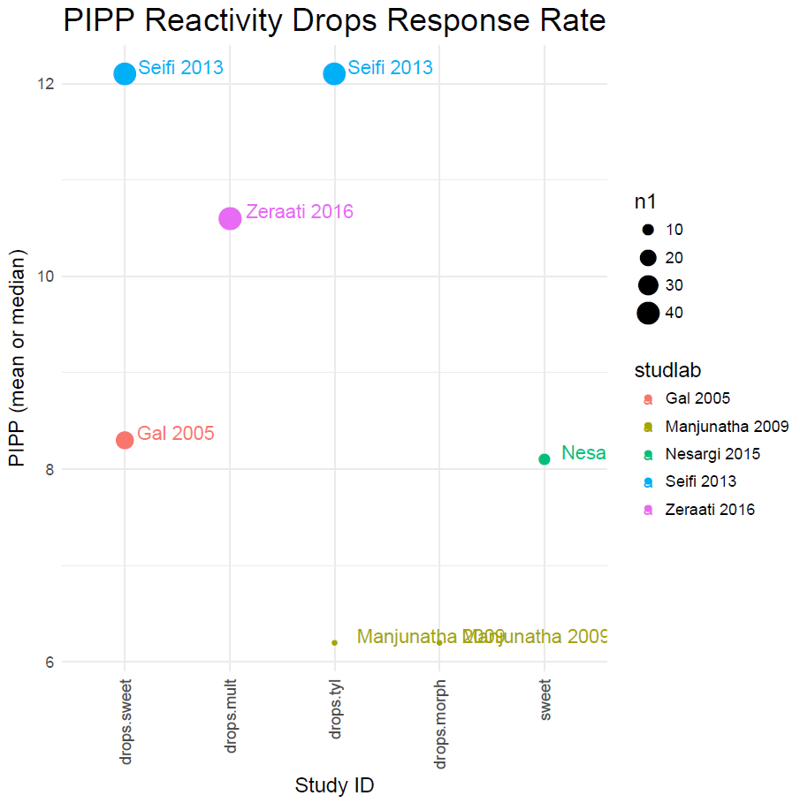
PIPP Recovery Drops Response Rate Scatter

Slide 27
Challenges
Network Heterogeneity
Some potential help from informative priors
Limitations of underlying studies
Potential to explore through meta regression (less likely for recovery outcome)
Potential publication bias
Swaddling vs Containment
Timing of measurement – more predictable effect in recovery

Slide 28
Next steps
Contact study authors for missing data
Intervention characteristics, scleral depression, swaddling vs containment
Proceed with analysis as decided today
At next meeting
All pairwise analyses for all outcomes
All base-case analyses
Sensitivity analyses on the following
Outliers
Cross-over trials
Imputed means
Posters
Assessment of potential targets for meta-regression
Interim NMA
Other than Olsson, no treatment led to minimal or no pain
Absolute risks?

Slide 29
Questions for the group
Comfort with treatment groups
Possible avenues for absolute effects
Use control arms of anesthetic drop studies to estimate baseline PIPP
Estimate number with an MID? Number with PIPP < 6?
Displaying multiple outcomes
Target journal
Difficult without full analysis complete, but important to consider now to help shape figures/tables/analysis choices

Slide 30
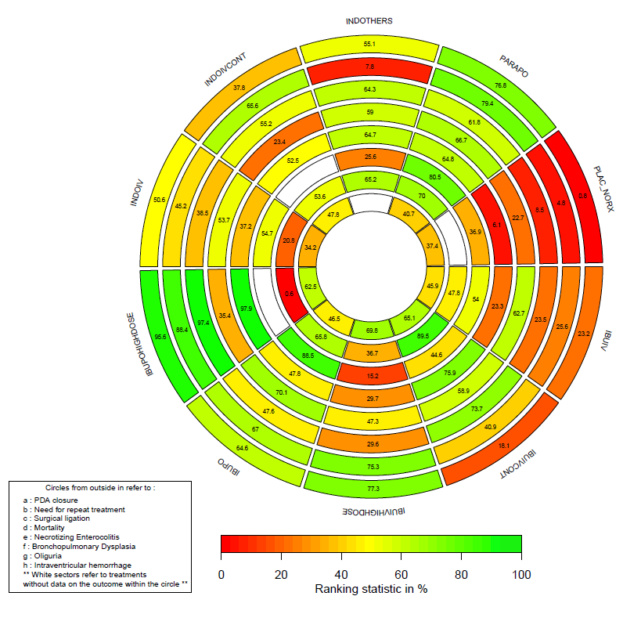
Notes:
Part of Coursework

Slide 31
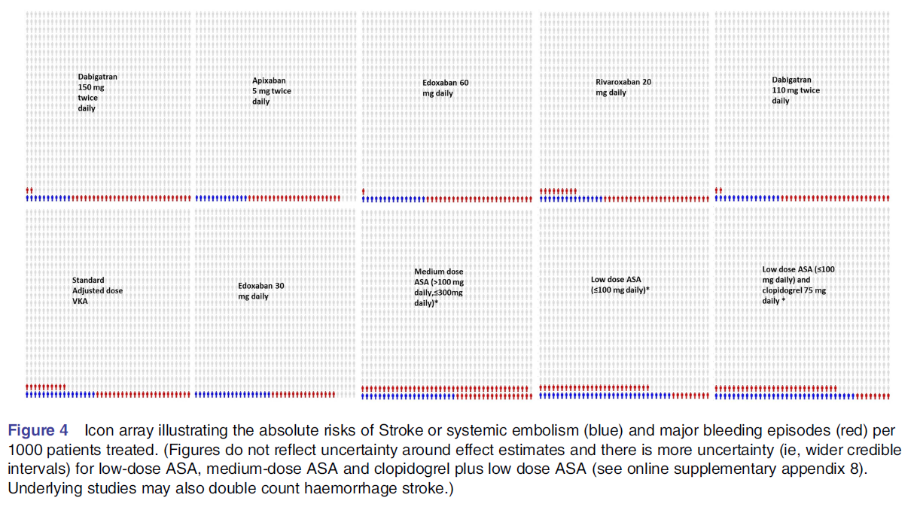
Notes:
Part of Coursework

